Slide 1
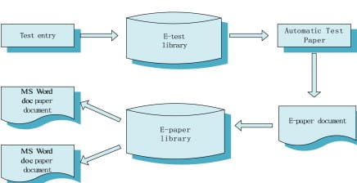
System Architecture
Fig: System Architecture

Slide 2
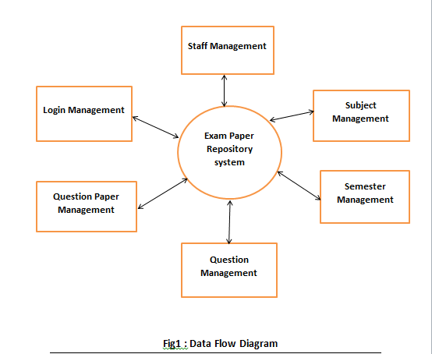
Data Flow Diagram

Slide 3
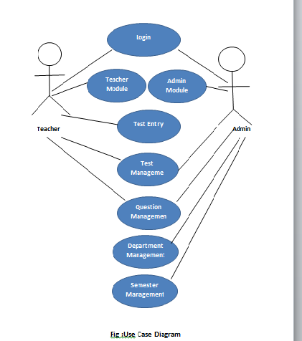
Use Case Diagram

Slide 4
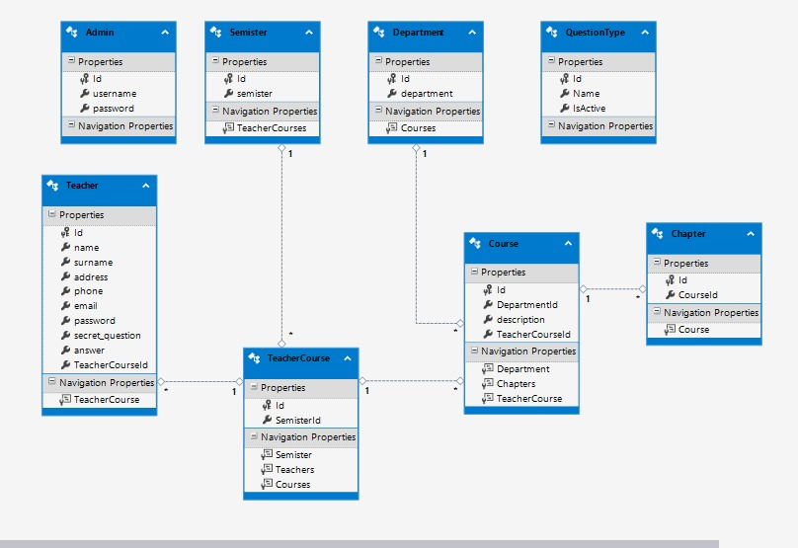
Class Diagram
Fig: Class Diagram

Slide 5
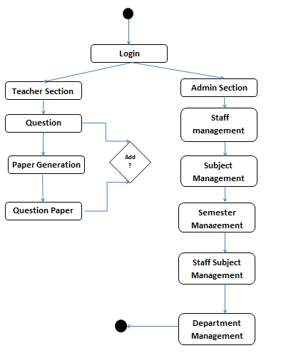
Activity Diagram
Fig: Activity Diagram

Slide 6
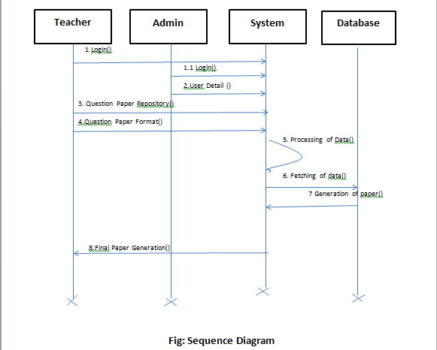
Sequence Diagram

Slide 7
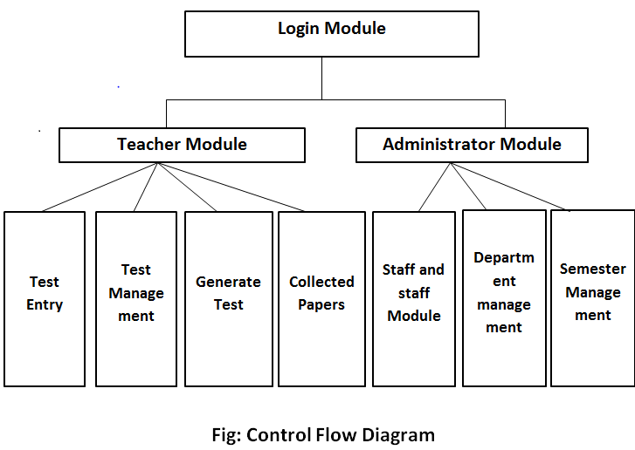
Control Flow Diagram

Slide 8
Snapshots =>

Slide 9
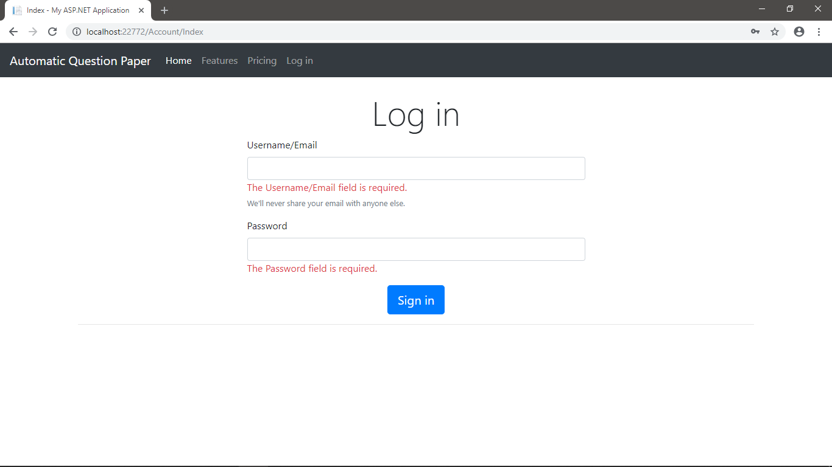
Login – Admin & Staff

Slide 10
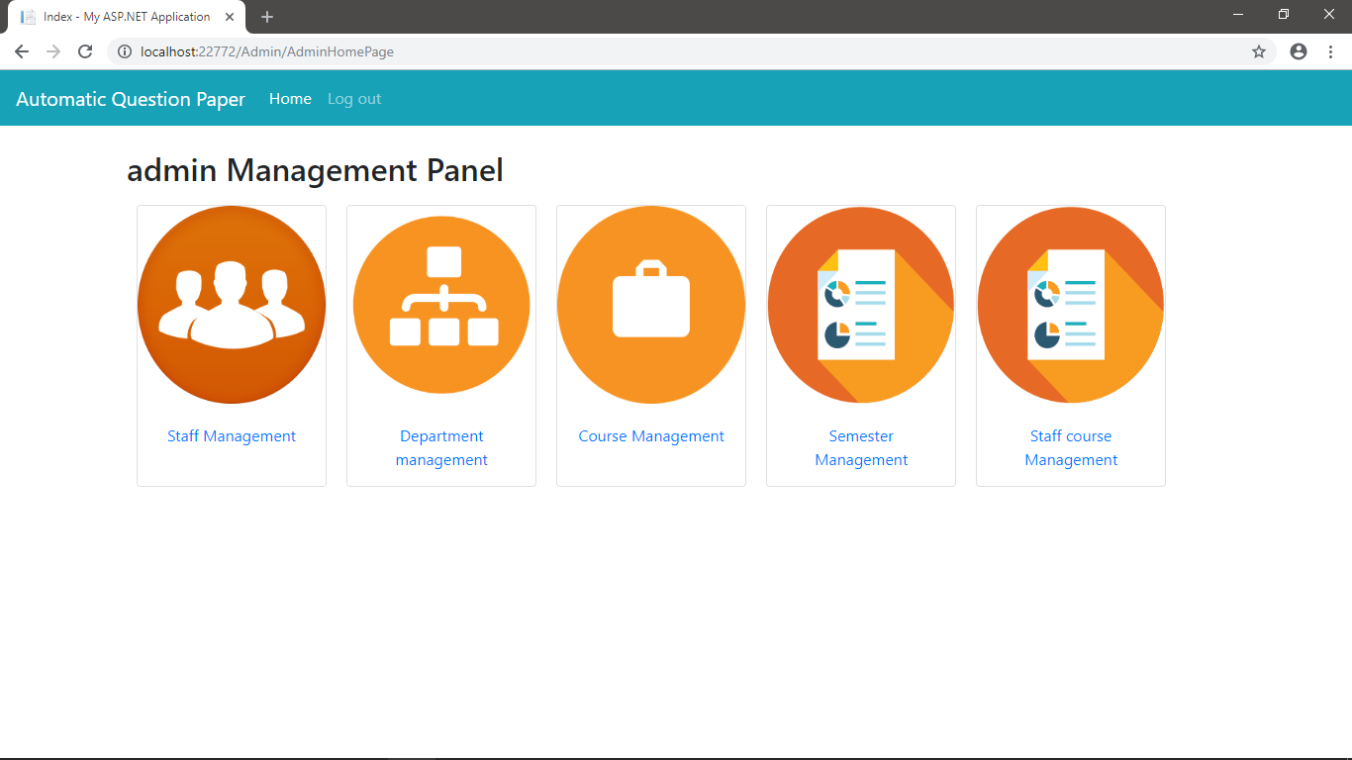
Admin management panel

Slide 11
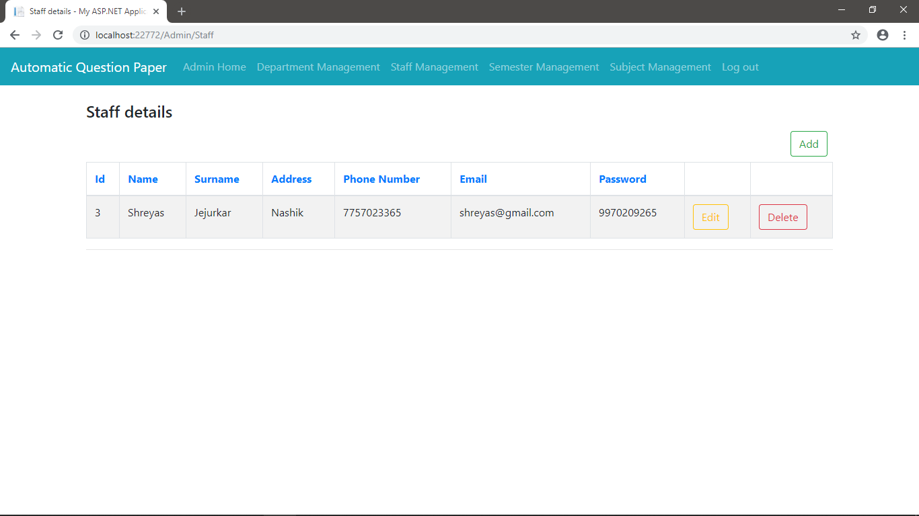
Staff management

Slide 12
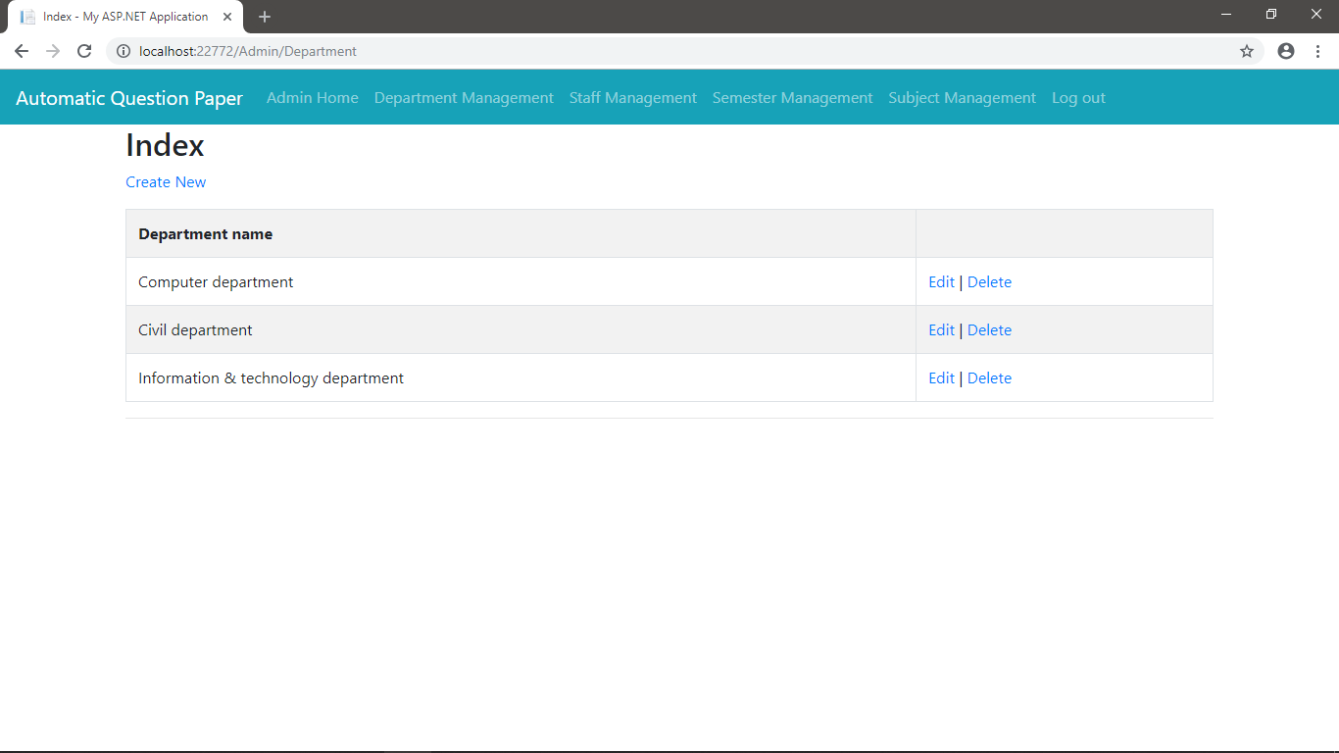
Department management

Slide 13
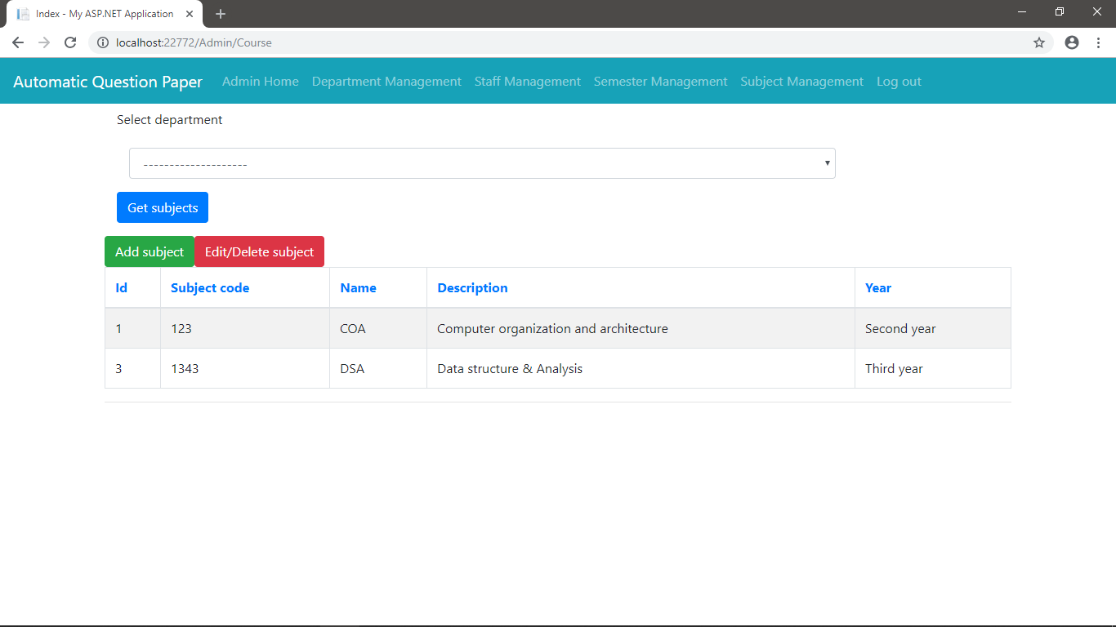
Subject management

Slide 14
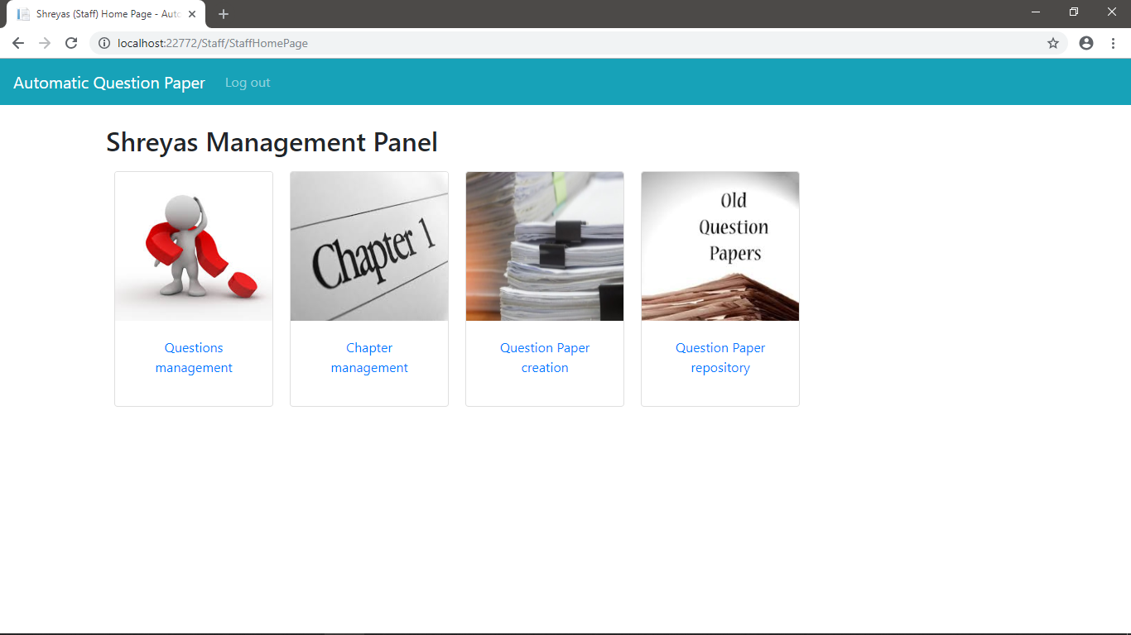
Staff management panel

Slide 15
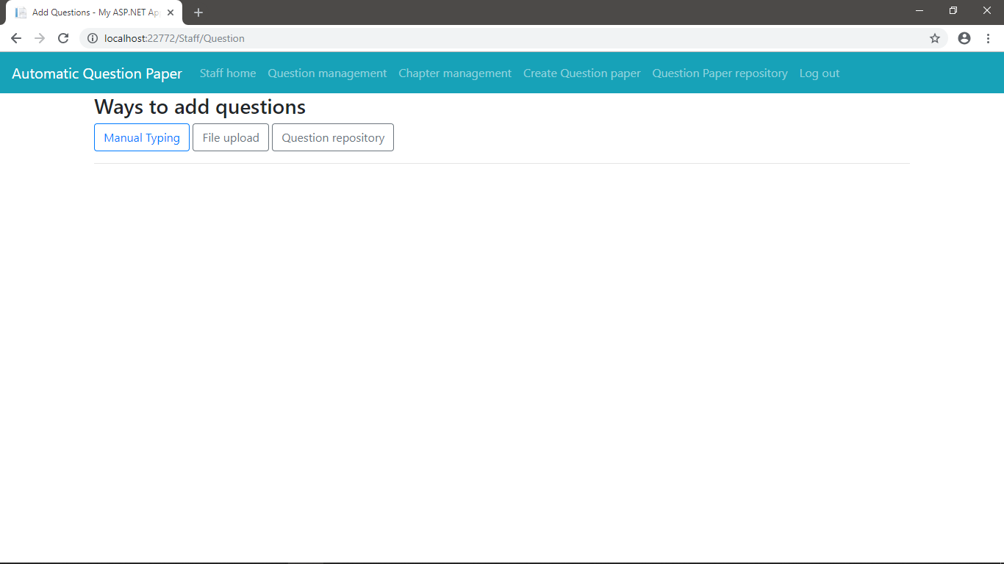
Ways of adding questions

Slide 16
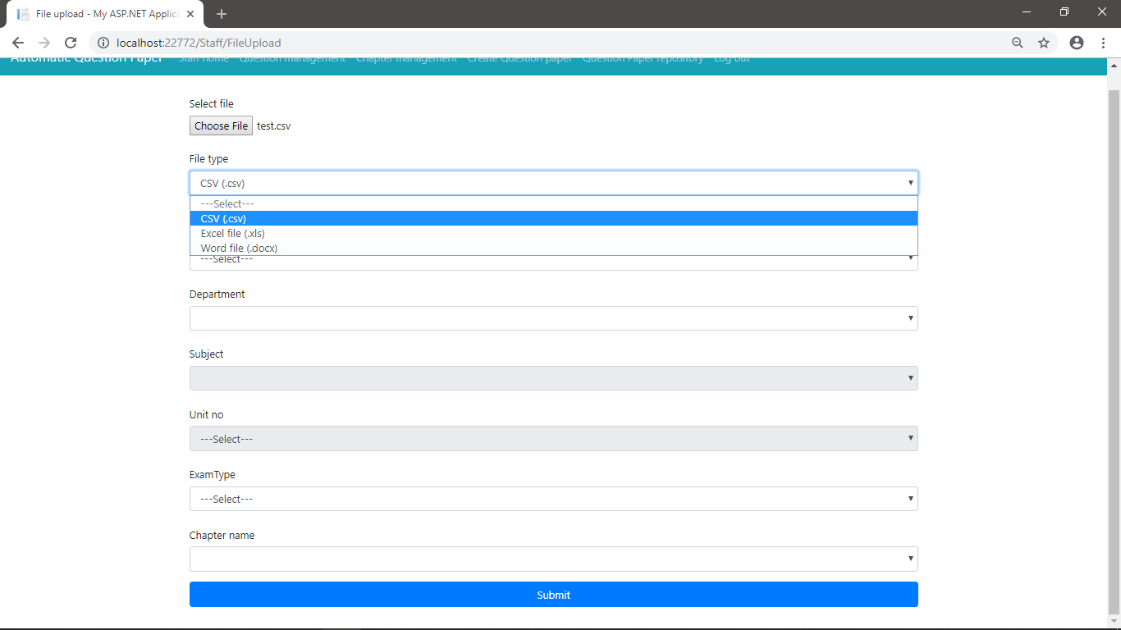
Adding questions via file upload

Slide 17
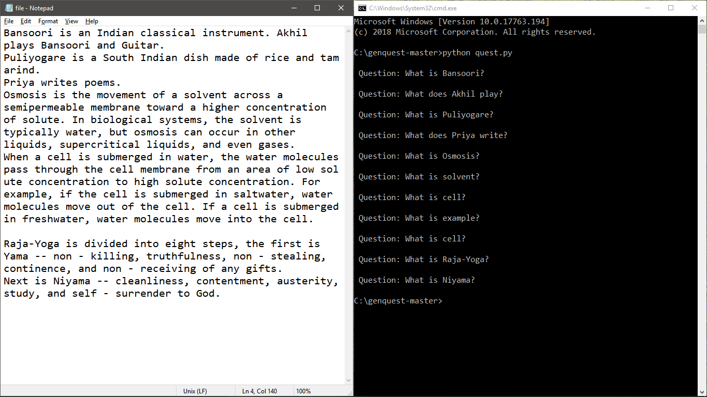
Generating questions from paragraph

Slide 18
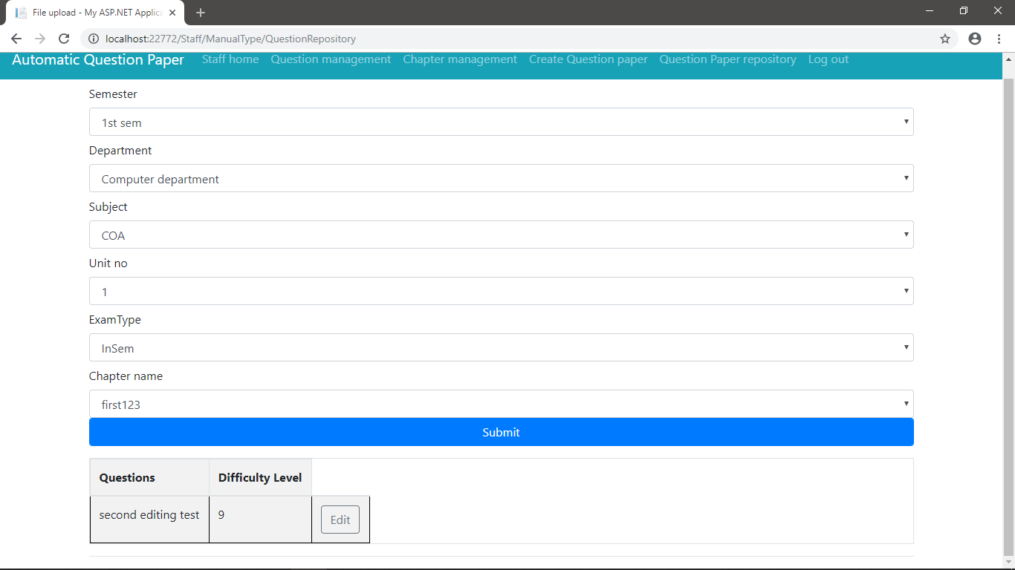
Questions repository

